Slide 1
AP Statistics
Preliminary Chapter
What is AP statistics?

Slide 2
AP Stats is hard!
  Lots of vocabulary and lots of concepts
To be successful in this class these are the things that you need to do
  Be engaged every class, lots of thinking, must be active
  Randomized grouping, work with different people
  Do your assignments and bring them every class, discuss your work each other, check your answers
  It is the responsibility of the student to make sure that you complete and understand everything in your homework
  Read your textbook – This is a MUST, not everything is covered in class
  https://drive.google.com/file/d/1y3qeXhs3Xty5iIZQYn-ebXX83bMrV5tH/view
  Work on your writing skills, be very precise with your words
  Know exactly what you are talking about and how to articulate your thoughts
    This will make you smart and powerful!

Slide 3
What is Taught in This Course?
Part 1 – Data Analysis (Ch:1 to 4)
  Learn how to organize data visually and also to describe it contextually
  Use boxplots to compare data from different populations – spread, distribution, central tendencies, where the middle is
  Understanding normal distributions and relative standings – comparing results relative to their populations
  Using Regression models to use “x” to predict “y”
Part 2 – Experimental Design (Ch5)
  How to create an experiment to establish causation
  Creating and generating simulations of an experiment using probability
  How to collect a sample/survey using Randomness
Part 3 – Probability (ch6 to 8)
  Binomial (0,1) and Geometric Distributions (up to how many)
Part 4 – Inference (Ch9 to 15) BIG ONE!!
  How to collect sample(s) to make conclusions/assumptions about the population!
  Confidence Intervals and Hypothesis Testing

Slide 4
Key Rules with Statistics:
Read Questions carefully and know exactly what is being asked
  Identify “WHO” subjects are and “Where” they are collected from
  “What” are the treatments, “What” is the population of interest
  “How” are the variables measured, “How” is the data collected
  “Why” does this work? “What” concepts are we using?
Learn to writing your answers in complete and coherent sentences
  Use only information and facts that is given to you, never make something up!
  Use data to support and justify your answer: No justification = Stupid answer
  Interpret your results - Be clear and precise of your subjects and treatments
  If asked to describe something, find out exactly what you need to describe: ie: Shape, skewed, spread, direction, ….
Avoid definitive language
Always be mindful of the conditions before making any conclusion
  What it a simple random sample? Or is there any bias in the sampling?
  Does the info apply to everyone or just with a certain population?

Slide 5
What you will Need for this course:
Graphing Calculator T.I. 83/84…… [Ti-84 is better]
  Most calculations can be done using graphing calculator
  Emphasis is on the interpretation and analysis of data, not so much on the math involved
Electronic Device to access online materials
  Teams (post updates and quizzes)
  Quizzes and Tests – Online Forms, please check regularly
  Assignments – Classroom Notebook (Teams)
Complete Daily Assignments
Textbooks
  Hardcopy (3rd Ed) OR Electronic (5th Ed)
  https://drive.google.com/file/d/1y3qeXhs3Xty5iIZQYn-ebXX83bMrV5tH/view

Slide 6
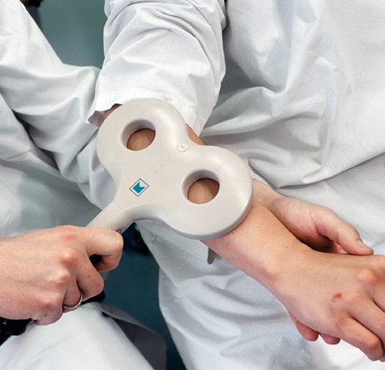
I) Can Magnets Reduce Pain?
50 polio patients were recruited in a study and asked to rate their pain levels after a magnet treatment
0 (mild) → 10 (severe pain)
29 received active magnets and 21 received inactive magnets (Placebo)
Data is as follows:
Active: 0, 0, 0, 0, 2, 2, 2, 2, 2, 3, 3, 3, 4, 4, 4, 4, 4, 4, 5, 5, 5, 6, 7, 7, 9, 10, 10, 10, 10
Inactive: 4, 7, 5, 6, 6, 8, 8, 8, 8, 9, 9, 9, 10, 10, 10, 10, 10, 10, 10, 10, 10,
Q: What statistics will you use to determine if the magnets were effective in treating pain? ie: Mean? Median? Mode? What else?
Q: Do you think the data suggests that magnets can reduce pain? Use the data to justify your findings.

Slide 7
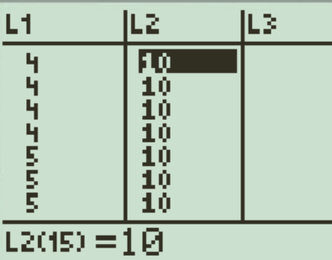
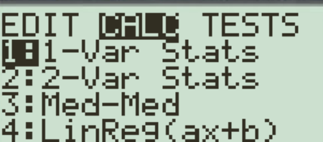


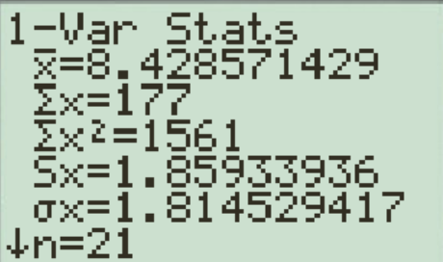
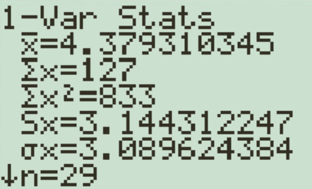
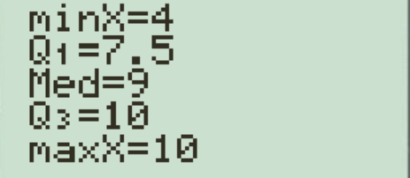
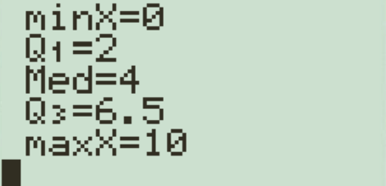
a) To determine the effectiveness of magnetic treatment for pain, we will look at the central tendencies of mean, median, and mode from the data of both groups
Remember, all calculations ca be done using Ti83
So enter data into Ti83 Press “Stat” “Edit”
Perform a 1-Var. Stats Calc
for each list separately
Mean: 4.37931
Mean: 8.428571
Median: 9
Median: 4
Mode: 2
Mode: 10

Slide 8
The patients in the active magnet group reported a lower level of pain threshold. In the active magnet group, the mean was lower by 4.05, the median lower by 5, the mode was lower by 6, Q1 was lower by 5.5, the minimum is lower by 4, and Q3 was lower by 3.5.
This suggests that patients in the active magnet group gave a lower pain rating than the inactive magnet group.
Don’t say that the magnets work, the magnets reduced pain….
Don’t use the word “differ”
BE PRECISE!!!

Slide 9
b) Observing the data, the responses from the active group number 1 had a much lower mean (4.37), median (4), and mode (2) than the second group with an inactive treatment.
The responses on pain levels in the second group had higher mean (8.43), median (9) and mode (10). This could suggest that the patients in the 1st group had lower pain responses than the 2nd group.
Note: Write your answers in complete sentences. Use the data to support your answers. Do not make any conclusions yet!!
Before we can conclude that the treatments were effective, here are some things that we need to ask:
Q:How were the samples in each group decided. Was there random grouping or did one group have a dominant characteristic?
Age could a variable that could affect the responses. One group could have older patients that are more susceptible to pain
Q: Was the experiment double blinded?
Could the person forming the experiment give away the placebo and affect the responses
Q: What was measured? Neurological Pain receptors? Or verbal response? (bias)

Slide 10

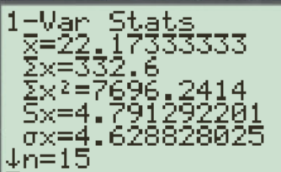
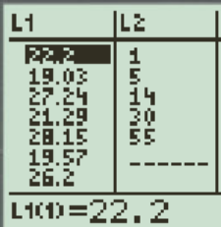
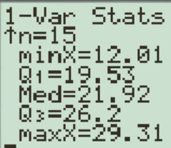
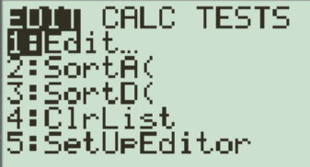
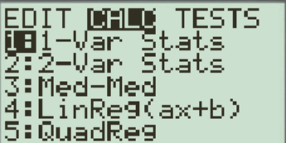
Using your Ti83 – Calculating Central Tendencies
The fastest way to find your “measures of central tendencies”, plot the data in your graphing calculator!
Press “STATS” and then “Edit” your lists
After you finish entering your data, press “Stats” again and then “Calc”
Do a 1-variable statistics calculation of your data set to get all your statistics
Make sure to indicate that you are calculating from list L1

Slide 11
Categorical vs Quantitative variables
Categorical Variables (aka Qualitative Variables)
  Categorical variables represents ‘qualities’ or “characteristics” of individuals or objects and are separated into different categories
  ie: gender, race, colours, name brands, type of jobs, YES/NO/Maybe...
  Can not be measured in any meaningful way, analyzed using frequencies and percentages
  Note: Some categorical variables can be numerical, but have no units of measurement: Zip code, Social Security Numbers
Quantitative Variables
  Quantitative variables have measurable ‘quantities’ and take on numerical values
  Ie: Age, income, weight, lengths, costs,
  These variables have units of measurement
  Quantitative variables can be “continuous” [fluid] or “discrete” [whole values]
  Analyzed using mean, median, standard deviations, variance,….

Slide 12
The people or things that we are measuring are called “individuals”
The accumulation of all the individuals of interest is called the “population”
A small group of individuals taken from the population to be studied is called a “sample”
When collecting data, the characteristics that we are measuring are called “variables”
  Ie: that mass, colour, age
“Confounding Variables” or “Lurking Variables” : variables that have an effect on our response variable that we are not aware of
  There’s a difference between “confounding” vs “lurking”
  Ie: The effect of exercising on health. Those who exercise also changed their diet patterns, which also helped improve health. So diet is a confounding
  variable

Slide 13
Ex: 50 polio patients were recruited in a study and asked to rate their pain levels after a magnet treatment
With the previous example on magnetic treatments with pain, indicate what the following are:
Individual:
A person with Polio
Population:
All people with Polio
Sample:
The 50 patients that were recruited
Variables:
Receiving Magnetic Treatment or Not Receiving Magnetic Treatment
Responses of Pain levels ranging from 0 to 10 after a magnetic treatment

Slide 14
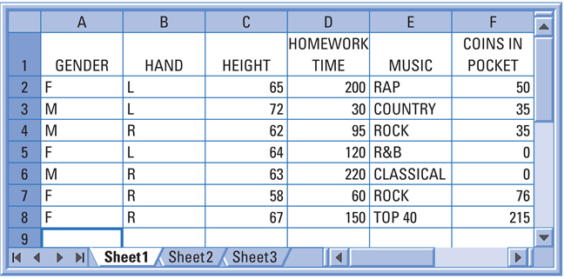
Ex: Given each scenario, indicate whether if the variables are Quantitative or Categorical. Indicate the units for the quantitative variables
Categorical
Quantitative
Gender
Height
inches
Hand
Homework Times
minutes
Music
Coins in Pocket
Number
of coins

Slide 15
Residents in South Burnaby were surveyed for the following variables. Indicate which of them are categorical or Quantitative:
Time in Canada
Qualitative: Number of years
Ethnic Background
Categorical
Postal Code
Categorical
Total Household Annual Income
Qualitative: Dollar value
Number of family members
Qualitative: Number of people
Licence plate number
Categorical
Nothing is measured, no units of measurement
Social Insurance Number
Categorical

Slide 16
The following table displays data that describes NBA players as of opening day of the 2019 season:
Players:
Steph Curry
Lebron James
Giannis A.
Pascal Siakim
Fred Vanfleet
Vince Carter
Team:
Warriors
Lakers
Bucks
Raptors
Raptors
Hawks
Position:
Guard
Guard
Forward
Forward
Guard
Sm. Forward
Age
31
34
24
25
25
41
Height:
6’3” 6’8” 6’11” 6’9” 6’0” 6’6”
Weight:
190
250
242
229
190
220
Salary:
37.5m
35.7m
24.2m
1.2m
9.3m
4.3m
What individuals does this data set describe?
NBA players (on opening day of 2019 season)
Identify the variables recorded. Label each as “categorical” or “quantitative”
Indicate the units of measurement for each quantitative variables
Categorical:
Qualitative
Salary
Players
Age
(Million of $)
(Years)
Team
Height
(Feet & Inches)
Position
Weight
(lbs)

Slide 17
VI) Data Analysis: Making Sense of Data
When analyzing data, always remember:
WHO
Who are the individuals and how many there are
WHAT
What are the variables and their units of measurement
WHY
Why was the data collected. Was there a question that we wanted to answer
WHEN & WHERE
Data Produced? Current?
HOW
Experiment? Observational study? Survey?
WHOM
Who collected the data? Hidden agenda? Integrity?

Slide 18
V) Part 2: Sampling & collecting Data
Surveys:
  Select a sample representative of the population
  The subject is asked questions and responses are recorded
  Use sample results to draw conclusions about population
  Potential for dishonest responses, inaccurate results
Observation Study:
  Subjects are only “Observed”, measuring only variables of interest but do not attempt to influence responses – NO treatments
  Useful for finding a “percentage” of a group for doing certain things
  Subjects may/may not know that they are being observed
  Can NOT establish Causation
Experiment:
  Subjects are given treatments, places into different groups, and responses are collected
  Establish “causation” if there is Control Group

Slide 19
Practice: Given each scenario, indicate whether if it survey, observational study, or experiment.
i) 300 participants were monitored to study the effects of red wine on health. Quarter of the sample were frequent drinkers (3+ per day), moderate(4-7 per week), light(1/2 per week), seldom (1 or less a month). Their health is then monitored.
ii) Do cell phones cause cancer? 150 volunteers had their brains scanned for potential cancer cells. Each volunteer was assigned a cell phone to be used for a set number of hours each day. The volunteers were then scanned again through MRI in a monthly basis.
iii) Does coffee help or hinder studying? 150 students had their study behaviours and coffee drinking habits studied. 30% of students who drink coffee regularly got better grades.

Slide 20
Ex: Indicate which of the following are Observations and Which ones are Experiments
300 participants were monitored to study the effects of red wine on health. Quarter of the sample were frequent drinkers (3+ per day), moderate(4-7 per week), light(1/2 per week), seldom (1 or less a month). Their health is then monitored.
Survey?
Experiment?
Not a survey
Not an experiment because nothing is done to affect the subject’s behaviour
Observational Study?
This is an observational study because we are only observing (monitoring) their behaviour and nothing is done to affect their behavior

Slide 21
Ex: Do cell phones cause cancer? 150 volunteers had their brains scanned for potential cancer cells. Each volunteer was assigned a cell phone to be used for a set number of hours each day. The volunteers were then scanned again through MRI in a monthly basis.
Survey?
Experiment?
Not a survey
This is an experiment
Observational Study?
Not an observational study because they were assigned a cellphone. Something is given to volunteers with intentions to affect their behaviour

Slide 22
Ex: Does coffee help or hinder studying? 150 students had their study behaviours and coffee drinking habits studied. 30% of students who drink coffee regularly got better grades.
Survey?
Experiment?
Not a survey
Not an experiment because nothing is done to affect the subject’s behaviour
Observational Study?
This is an observational study because we are only observing (monitoring) their behaviour and nothing is done to affect their behavior

Slide 23
Given each scenario, indicate which of the following would be the best approach: Survey, Observation, or Experiment? Justify your answers
i) What percentage of males wash their hands after using the washroom?
ii) Does constant exposure to stress increase the chance of heart disease?
iii) Does listening to music while studying help or hinder learning?

Slide 24
What percentage of males wash their hands after using the washroom?
Survey?
A survey would be a good idea only if everyone that was surveyed was telling the truth.
Observational Study?
Place a camera in the washroom at the sink. Record the number of males who wash their hands. There could be legal issues with placing a hidden camera in the washroom
Experiment?
Can’t do an experiment because it isn’t a cause/effect scenario

Slide 25
Does constant exposure to stress increase the chance of heart disease? Which approach would be best to investigate this issue? Explain your answer.
Survey?
No, a survey could be bias since it can be based on public opinion rather than scientific facts.
Observational Study?
We can observe the level of stress from a group of patients with heart disease. However, many variables can also affect your heart. Ie: eating habits, exercising, genetics...etc (too many confounding variables) → NO
Experiment?
Perform experiments on the effects of stress on the human body. Ie: How blood pressure, immune system are affected by stress. YES

Slide 26
Does studying while listening to music help or hinder learning? Which approach would be best to investigate this issue? Explain your answer
Survey?
No, answers could be bias based on opinion towards music
Observational Study?
People who don’t listen to music while studying “may” be smarter to begin with. Intelligence can be a confounding variable.
Experiment?
We can measure effects of studying with or without music in controlled settings (YES)

Slide 27
Part 3: Describing a Distribution:
Distribution tells us the range of values that the variable has and how often these occur
Later chapters involving calculations on distribution have to do with probability
To Describe a distribution, we will look at:
A) Center - Mean, Median, Mode, middle 50%, IQR
B) Spread – the range (max, min), Q1, Q3, Outliers?
C) Shape – either symmetrical or skewed, unimodal? Bimodal? Uniform?
Symmetrical
Skewed Right
Skewed Left

Slide 28
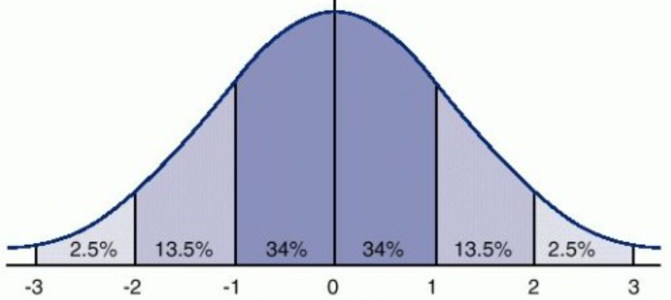
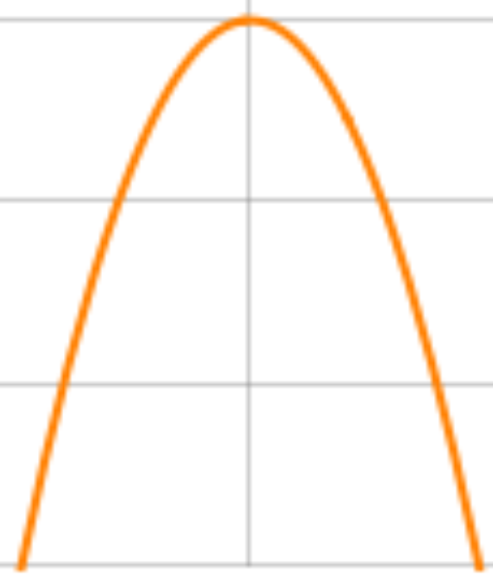
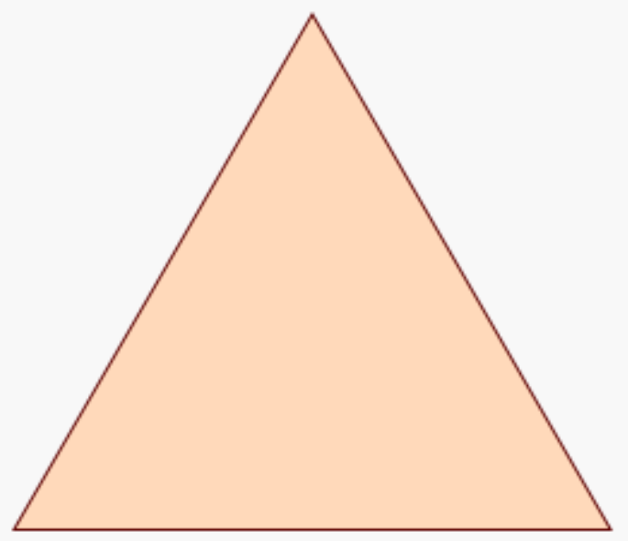
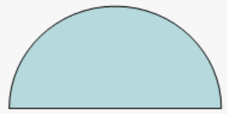
NOTE: This is a BELL CURVE!!
NOT THIS!
NOT THIS!
NOT THIS!

Slide 29
Dot Plots: The dotplot below shows the Math test scores of two classes of 20 students in a Calculus class. The first class regularly attended Tutorials and the second class did not. In your groups, discuss the following questions:
Not Attend
Attend
Q: Is there are positive effect in student scores from regularly attending tutorials? How would you justify your answer?
Q: What conditions should we consider before we can make any conclusions?
Q: What observations and appropriate evidences are there to support your answer

Slide 30
Dot Plots: The fathom dotplot below displays the Math test scores of 20 students in 1st in Calculus that did and did not attend a tutorial course. Is there a positive effect in student scores from attending the tutorial? What conditions should we consider? What observations do you Give appropriate evidence to support your answer
Not Attend
Attend
1st step: Find the central tendencies for each class:
Note Attend
Median:
Mode:
Mean:
Attend
Median:
Mode:
Mean:
Students that attended the tutorial had a higher median, mode, and mean scores than students that did not attend

Slide 31
Homework:
Read through pages 3 to 33 in your textbook
P30 : Q19, Q21, Q24

